Slide 1
Enter the Mongoose!
Day 56?
May 28, 2016

Slide 2
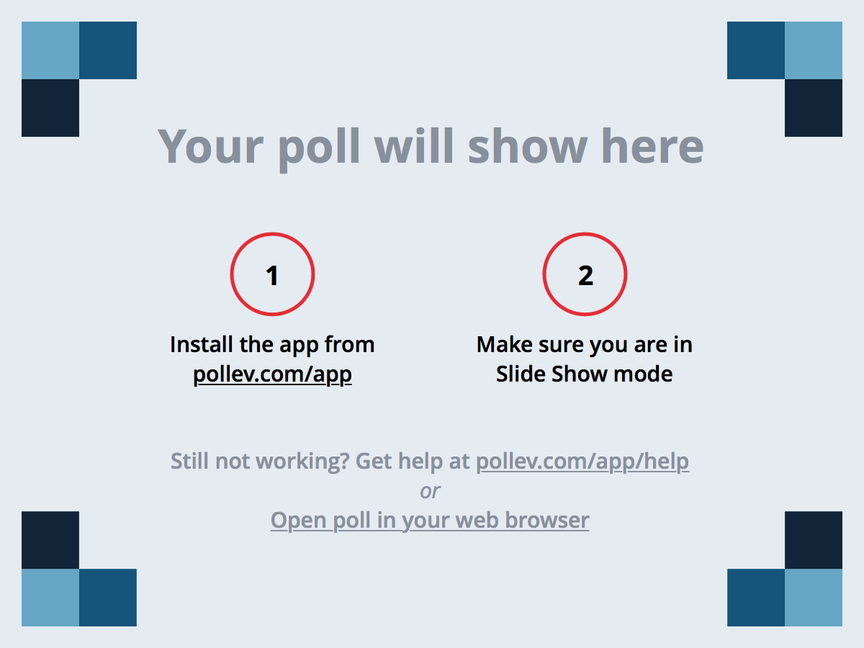
Notes:
Poll Title: How should we do class today? https://www.polleverywhere.com/multiple_choice_polls/xMxn2m5jSGrG5yj

Slide 3
But First…

Slide 4
Projects Ahead!
Start brainstorming about your projects!
The goal is simple: “Build something awesome”.
Only major new requirement is that you incorporate an element of “market research” in your project.
Talk to potential customers.
Create an MVP and test it with users.
Do a little bit of online research.
Etc.
Effectively, we want you to show us that your final project isn’t just a random Frankenstein of tech – but something that is of viable utility to the real world.

Slide 5
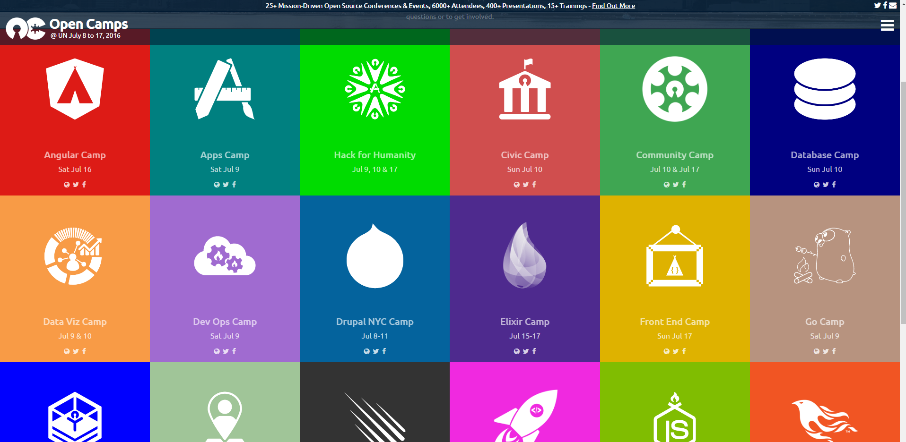
(FREE) Tech Camps at the UN: Jul 8 – 17
Definitely make the time if you can!
Tech events like this typically cost hundreds or thousands to attend.

Slide 6
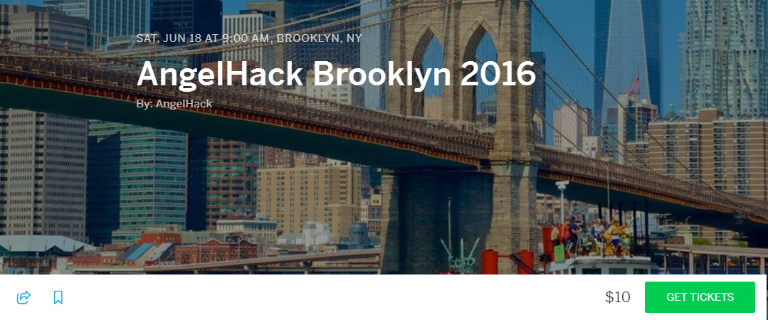
Brooklyn Hackathon: Jun 18 - 19
Topic: Build a technology that will have a positive impact on the world, people, or environment.
Seriously. Consider attending. You could win. You have all the skills you need and its super fresh on your minds.

Slide 7
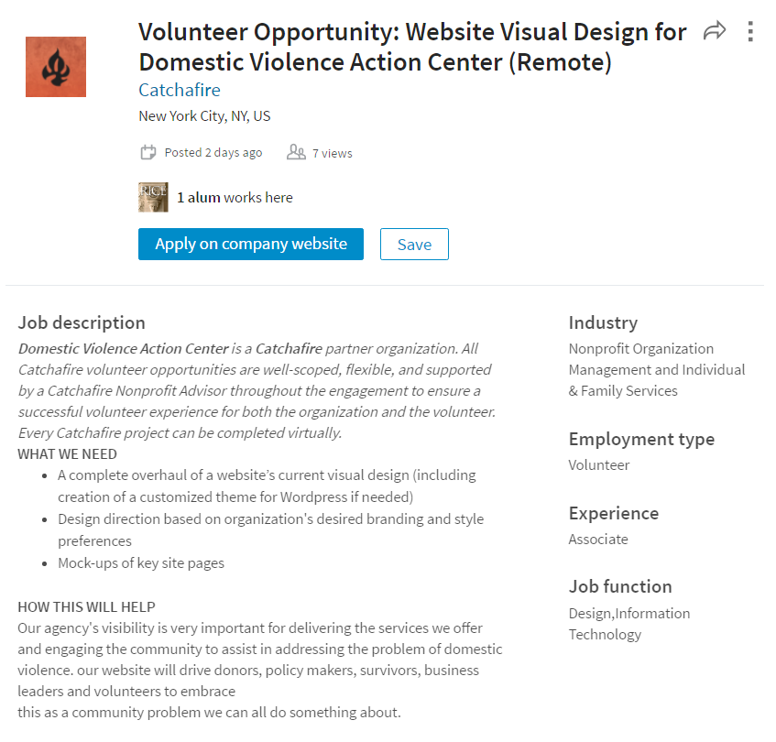
Volunteer Web Development Postings
LinkedIn search for “Volunteer Web Developer”.
There are some great opportunities available in the NYC Area.
These are perfect opportunities to build your resume and show that you are passionate about using your skills.

Slide 8
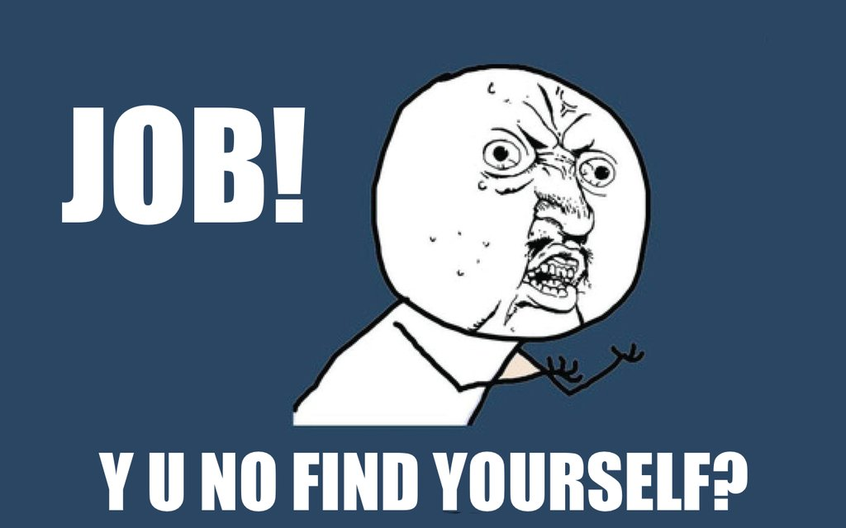
Demo Day + Career Services
Definitely start preparing your portfolio pages We don’t have time in the schedule devoted to this per se… but it’s important. Make the time to invest in yourself.
Schedule 1:1s with Nalani to get extra coaching: When you do schedule something consider cc’ing John and I. That way we can offer Nalani perspective on your strong-suits.

Slide 9
Light Recap

Slide 10
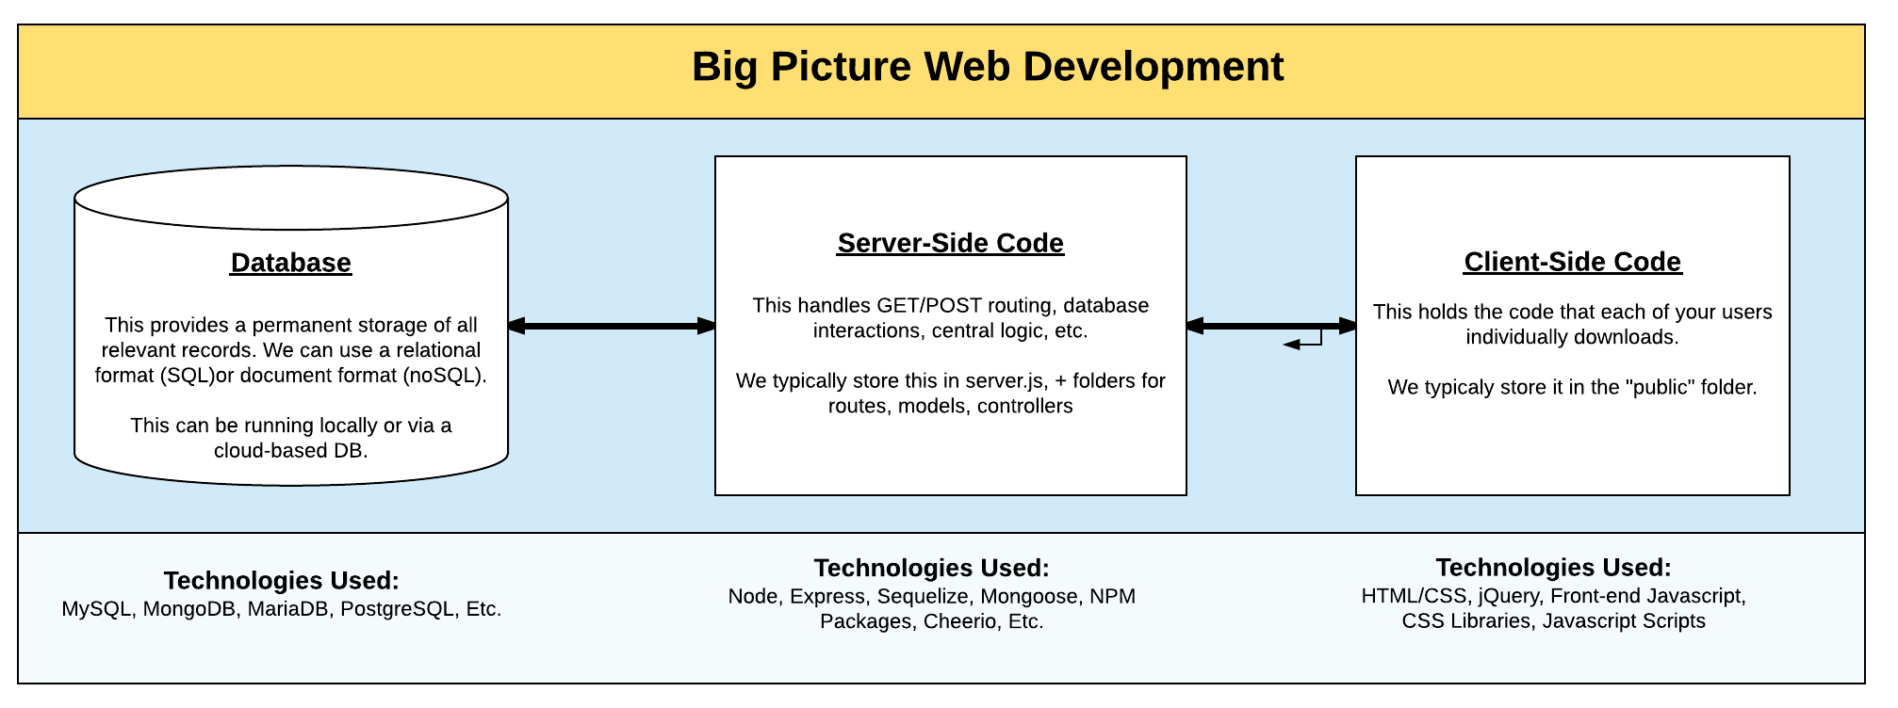
Databases, Servers, and Clients
We’ve covered a lot!
At this point the concept of this paradigm should be clear to you.
You should specifically see where MongoDB falls in.

Slide 11
Databases, Servers, and Clients
We’ve covered a lot!
At this point the concept of this paradigm should be clear to you.
You should specifically see where MongoDB falls in.

Slide 12
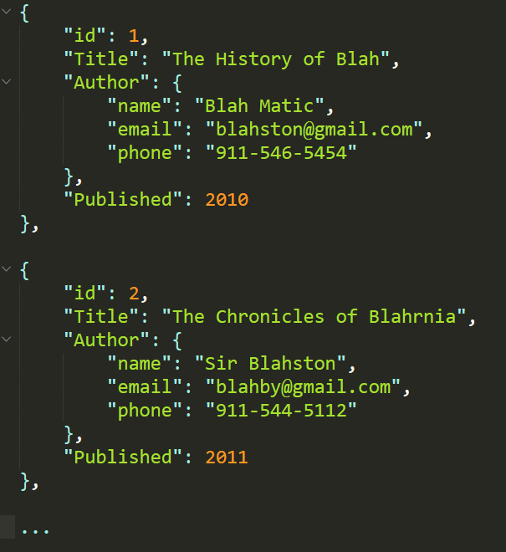
MongoDB – In a Nutshell
noSQL databases like MongoDB forego the concept of relational tables in favor of a document model.
Each data entry is effectively a JSON – making it really easy to implement.
MongoDB is especially good for data with many layers of nesting.

Slide 13
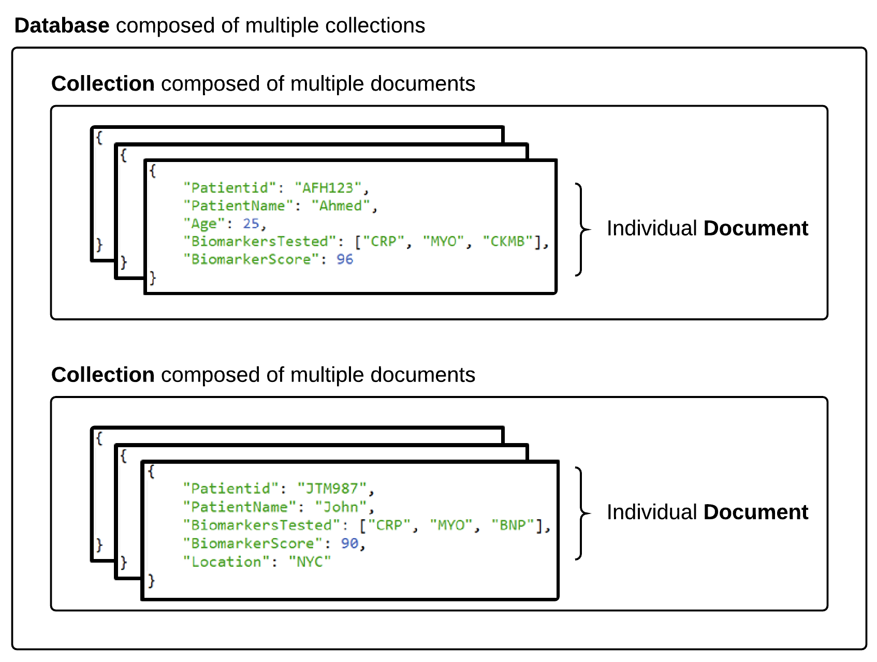

MongoDB Storage

Slide 14
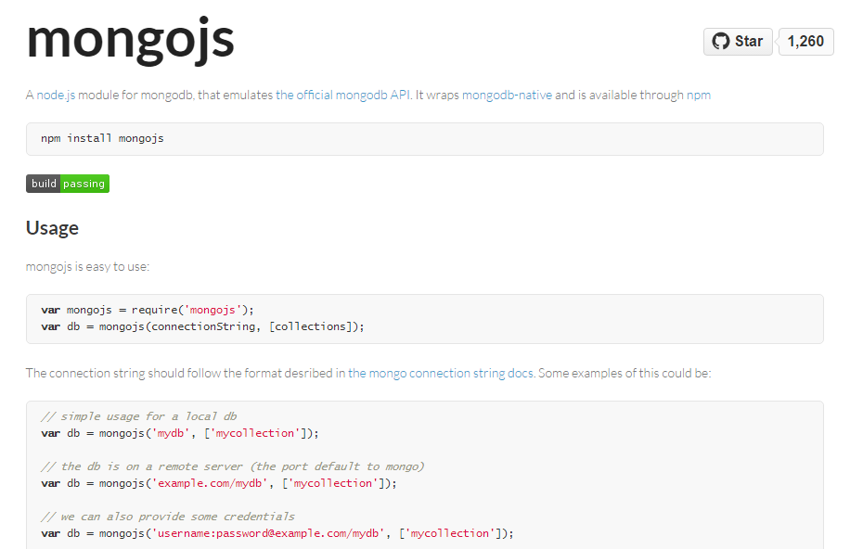
MongoJS: Node-Based Driver
In class, we then introduced you to Mongojs – a node module that acts as an interface between Node and MongoDB.

Slide 15
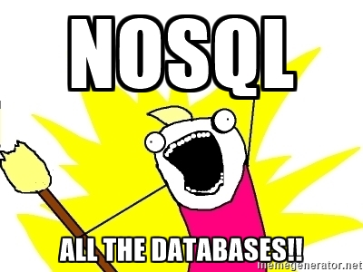
MongoDB Advantages
Data is basically just a giant array of JSONs.
Data can be extremely heterogeneous.
It’s a cinch to add, delete, or update records.
There are tons of online databases available.

Slide 16
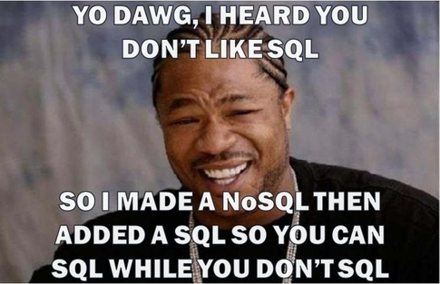
MongoDB Disadvantages
Querying across multiple “collections” isn’t supported. (The workaround is to do multiple queries – which creates performance issues at scale.)
Heterogeneous data is almost always a bad idea.

Slide 17
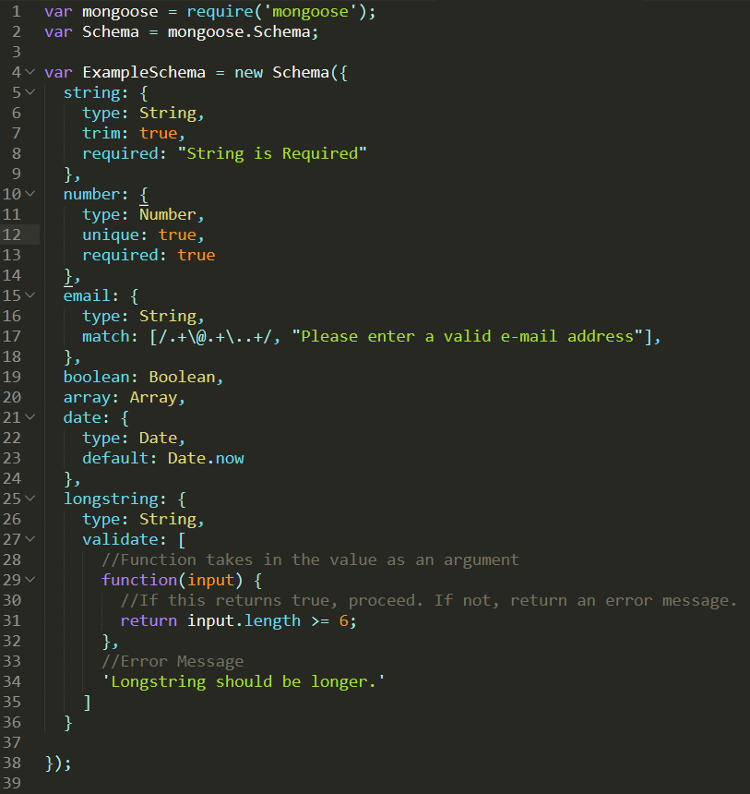
But I need that Schema doe…
Schemas are great because:
Sync: They ensure that your server code is directly synced with the DB.
Validation: It can stop users from inserting non-valid data into the DB -- screwing everything up in the process.
Ease of Use: Schemas can be setup to perform recurring tasks for all db interactions.

Slide 18
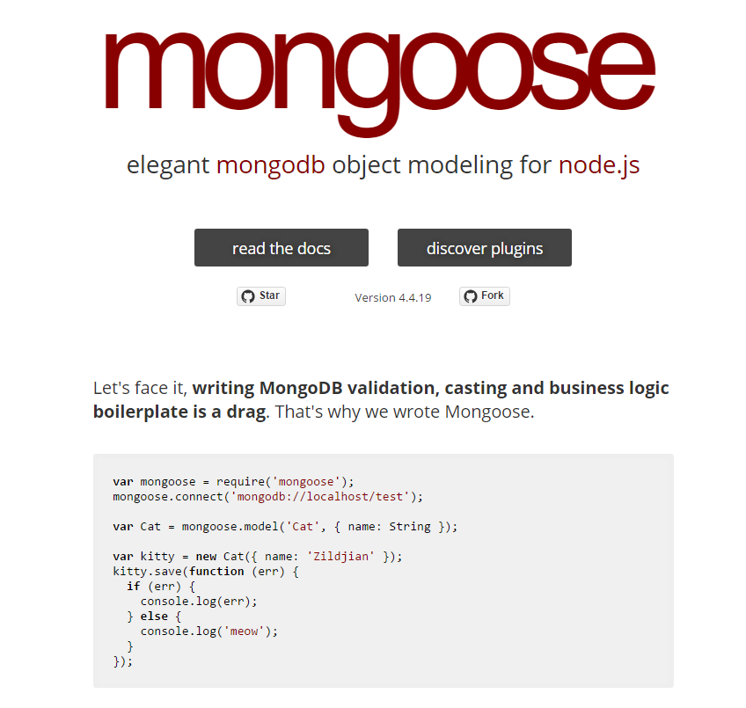

Enter Mongoose.JS
Mongoose is a much more comprehensive way to interact with MongoDB.
It provides a structure for building schemas and also a quick way to implement simultaneous query calls.

Slide 19
Time to Code!

Slide 20
Questions

